Slide 1



Development of experimental design
skills and systems thinking
MTA-ELTE Research Group on Inquiry-based Chemistry Education
Dr. Luca Szalay and Dr. Zoltán Tóth
ECRICE 2022, Weizmann Institute, Israel, 12. 07. 2022.

Slide 2
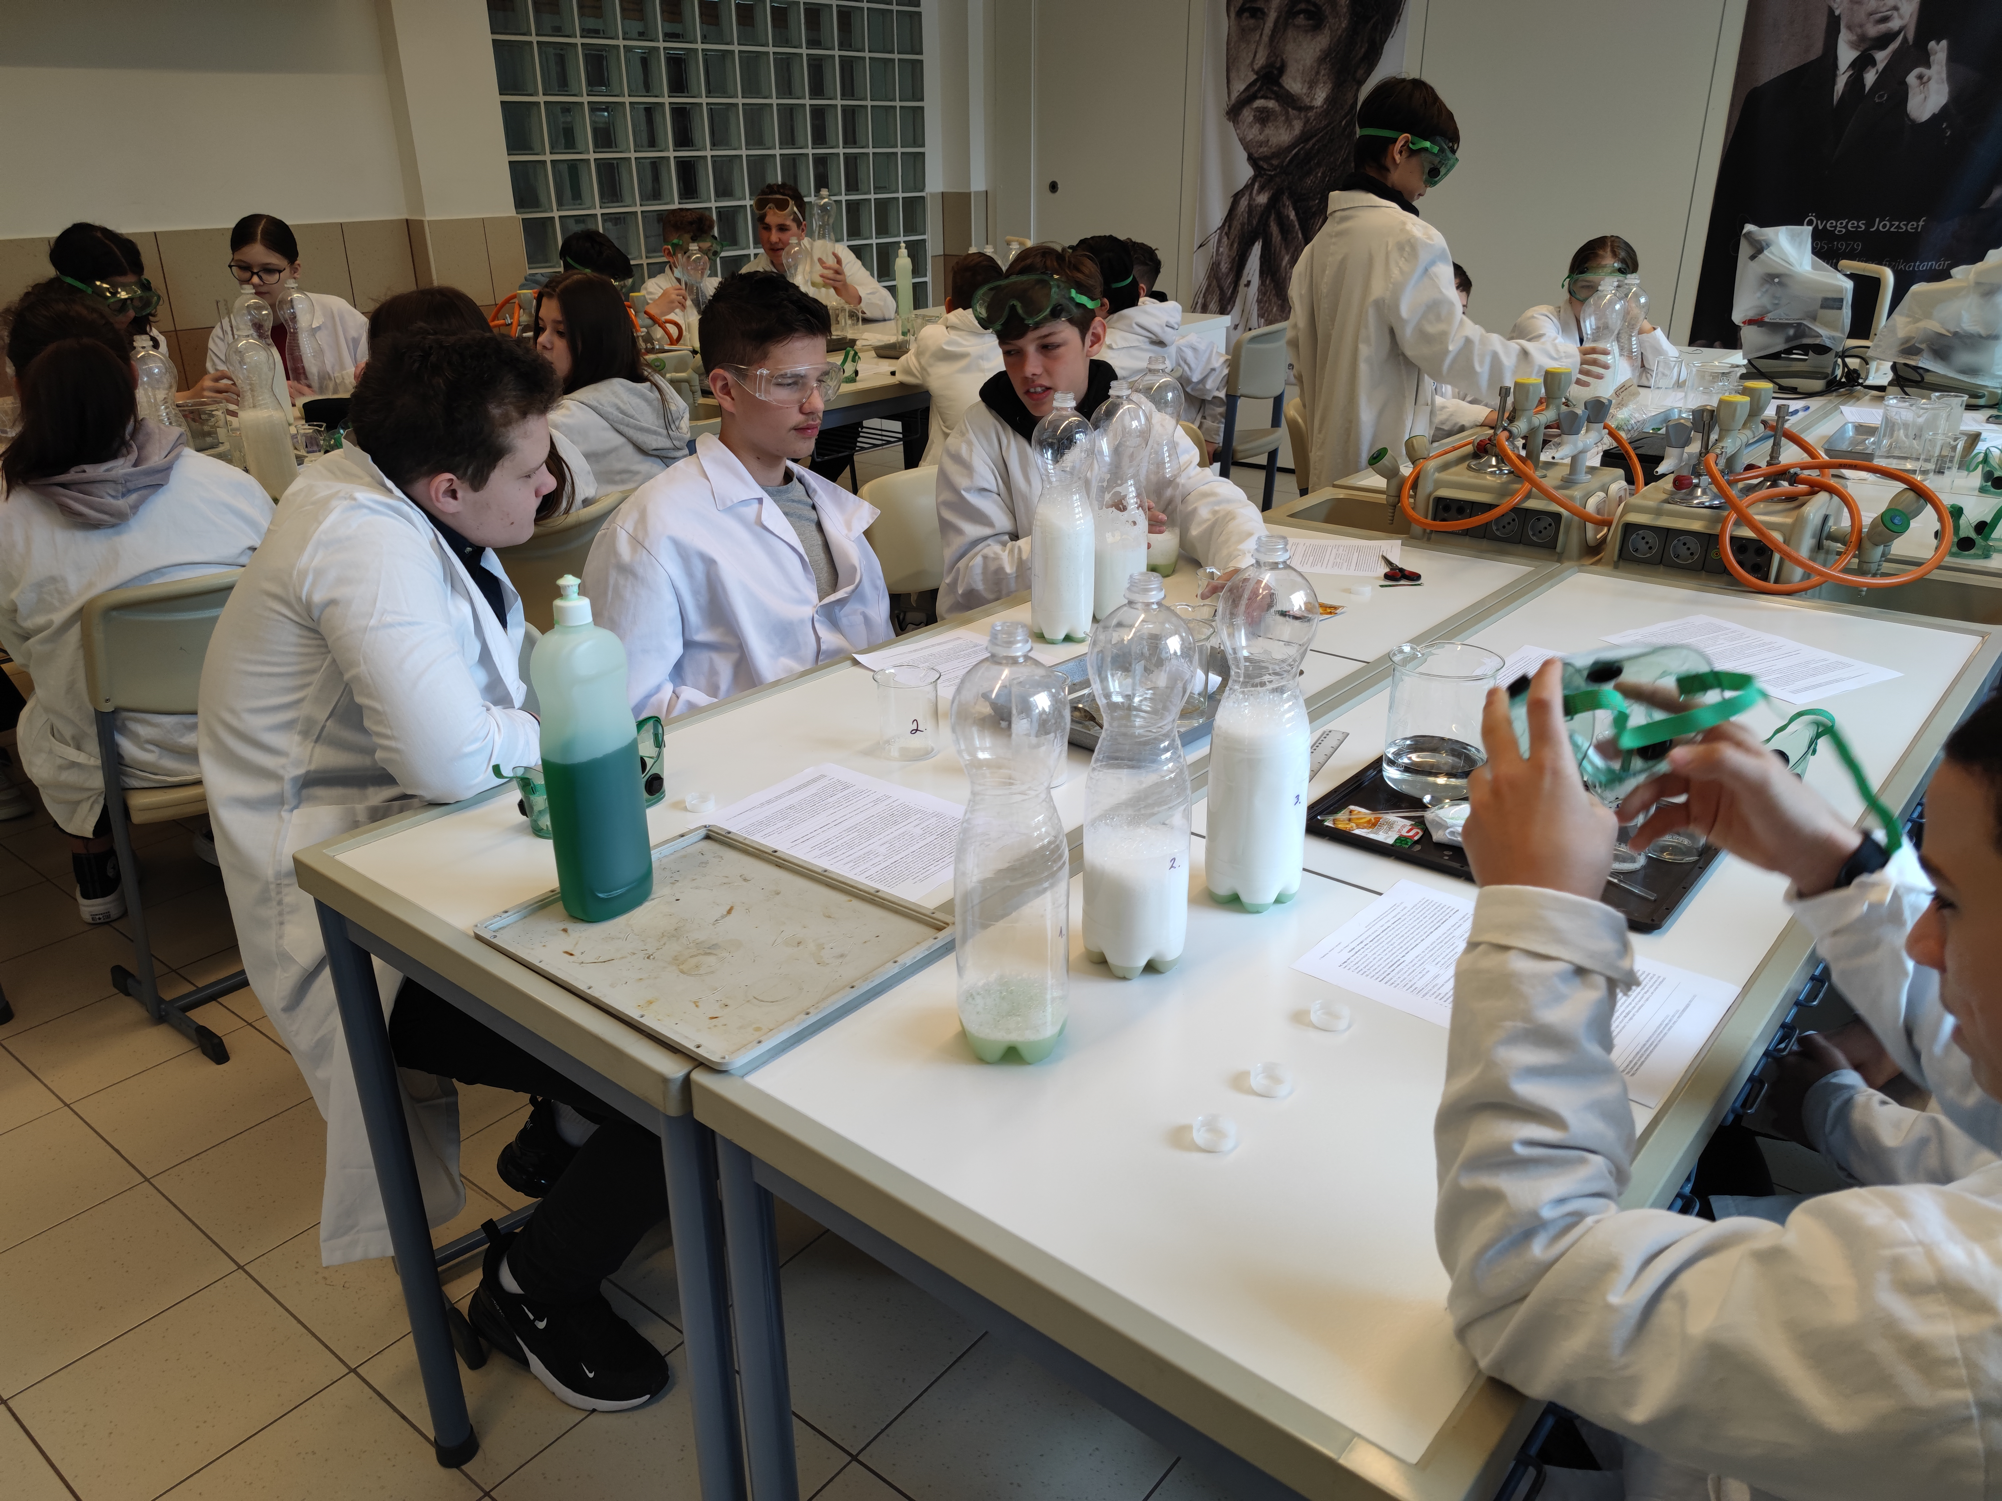
CONTENT
Introduction: concepts and goal
The previous 5-years project:
  Research model
  Results
The present 4-years project:
  Research model and questions
  Research method and sample
  Examples of tasks
  Statistical methods
Results of the first school year:
  Effects on the experimental design
  skills and disciplinary content knowledge
  2. Effects on attitudes
Discussion, conclusion and plans
ECRICE 2022, Weizmann Institute, Israel, 12. 07. 2022.

Slide 3
I. Introduction and concepts
„inquiry-based science learning/teaching/education” (IBL, IBST, IBSE): teaching/learning process is modelling the steps of scientific research
classification e.g. according to the measure of students’ independence:
*Essentially no inquiry: Xu, H.; Talanquer, V. (2013), Effect of the level of inquiry of lab experiments on general chemistry students’ written reflections. Journal of Chemistry Education, 90 (1), 21−28.
Type of inquiry | Is it known for the students… | Adott a
 | …the research question? | …the research method? | …the explanation of the results?
Open | no | no | no
Guided/Bounded | yes | no | no
Structured | yes | yes | no
Confirmation/Closed* | yes | yes | yes
ECRICE 2022, Weizmann Institute, Israel, 12. 07. 2022.

Slide 4
II.1. Research model from September 2017 (from Grade 8)
6 student sheets for 6 lessons
(45 min) in 3 versions:
Type 1: only step-by-step experiments
Type 2: step-by-step experiments + principles of experimental design explained AFTER the experiments
Type 3: principles of experimental design explained BEFORE the experiments and used in practice
First year (2016/17): no significant difference in the development of experimental design skills between the experimental groups and the control group →
lack of scaffolding did not work →
Statistical analysis of data
Choosing sample
Group 1
Pre-test
6 Type 1 student sheets
Post-test
Group 2
Pre-test
6 Type 2 student sheets
Data collection
Post-test
Group 3
Pre-test
6 Type 3 student sheets
Post-test
The important aspects of the experimental design (e.g. ‘other variables held constant’) were taught from September 2017.

Slide 5
II.2. Results of the previous project (2017-2021)
Structured paper and pencil tests (T0-T4); tasks intending to measure:
disciplinary content knowledge (DCK) + experimental design skills (EDS)
T2 (Grade 8): significant development in the EDS in both experimental groups
T3 (Grade 9): no significant development in the EDS
T4: COVID-19 disruptions → in June 2021 (Grade 11), no significant development in the EDS
School variables: stronger effect on the EDS scores than the intervention from T2!
EXPLANATIONS?
    Ability scores are confounded by motivational levels? –(Effect of T0!)
    Do the students need even more scaffolding? (Use of a „template”?) *
    *Cothron, J. H., Giese, R. N., Rezba, R. J., (2000). Students and research: Practical strategies for science classrooms and competitions, (3rd Ed.)., Dubuque, IA: Kendall/Hunt Publishing Company
ECRICE 2022, Weizmann Institute, Israel, 12. 07. 2022

Slide 6
III.1. Research model and questions from September 2021
6 student sheets for 6 lessons
(taking only cca. 25 min) in 3 versions:
Type 1: only step-by-step experiments
Type 2: step-by-step experiments + scheme filled in AFTER the experiments
Type 3: scheme filled in BEFORE the experiments and used in practice
Direct teaching of the experimental design skills
worked better in the previous project → Has the
teaching of using a scheme to help experimental design even more effect on EDS/DCK/attitudes?
Statistical analysis of data
Choosing sample
Pre-test
Group 1
6 Type 1 student sheets
Post-test
Group 2
6 Type 2 student sheets
Post-test
Data collection
Group 3
6 Type 3 student sheets
Post-test
Note: Context-based and systems thinking tasks are on each type of the students worksheets for motivational purposes.

Slide 7
III.2. The present project: research method and sample
 | Longitudinal research: 4 school years 2021-2025 (Grade 7-10)
Intervention | 6 lessons/school year (=24 lessons, partially spent with the worksheets)
Tests | Test 0 (T0): September 2021+T1 (T2, T3, T4): end of each school year
Number of students | (T0 and T1): 886
Age of students (years) | 12/13
Number of teachers | 31
Number of schools | 25
Group 1 (control) | only step-by-step experiments
Group 2 (experimental) | Scheme to teach experimental design AFTER step-by-step experiments
Group 3 (experimental) | Scheme to help experimental design BEFORE planning experiments
+ Motivation | Context-based tasks + elements of systems thinking for all the students
ECRICE 2022, Weizmann Institute, Israel, 12. 07. 2022

Slide 8
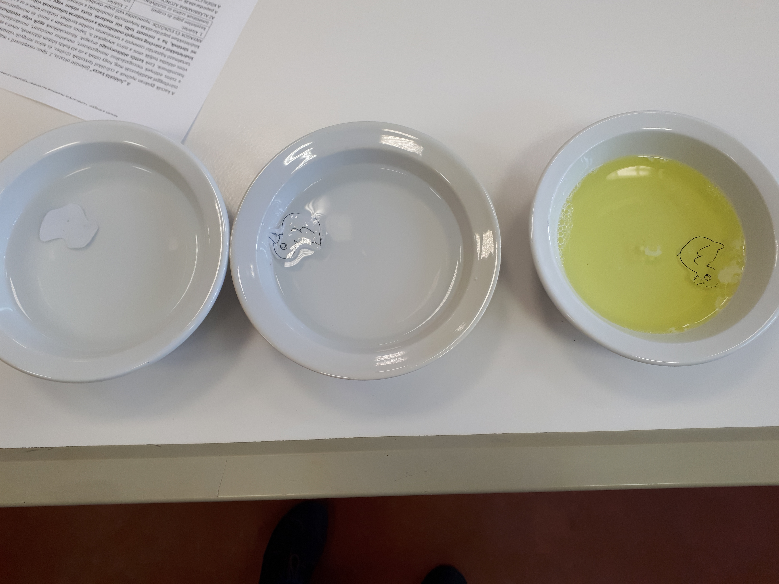
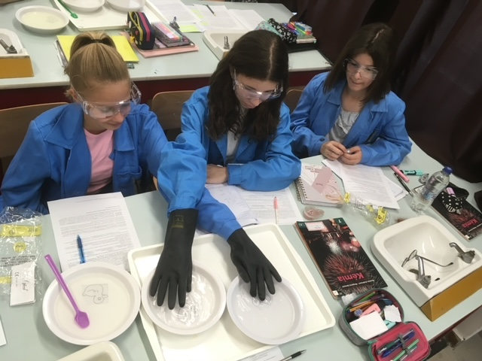
III.3.a Examples of worksheets
Topic of Worksheet 3: solubility (water and fat particles do not mix, but particles of dishwashing liquid/soap can mix with both)
Research question: How does the greasing of the ducks’
feathers affects whether they can swim or they sink in clean
water or water containing dishwashing liquid/soap?
Context-based: What is the solubility of alcohol if it behaves like soap in dissolving the outer shell of the coronavirus?
Topic of Worksheet 6: conditions of combustion
Research question: Are all the three of conditions necessary for combustion? (e.g. incombustible handkerchief…)
Context-based: How does the recent increase
in the frequency of forest fires is
contributing to global warming?
ECRICE 2022, Weizmann Institute, Israel, 12. 07. 2022

Slide 9
III.3.b Experimental design tasks on tests
EDS task from T0: Would a black coat or a white coat protect a snowman from melting?
  a) How many ice cubes do they need for the experiment?
  b) How many pieces of cloth are needed for the experiment and how should they look like?
  c) Where should the children put the ice cubes?
  d) How should the children place each piece of cloth in the case of each ice cube?
  e) What do the children need to observe to decide which of them was right?
  (f) Put a (+) sign in front of the statement(s) in the list below that are important…
EDS task from T1: Which of the three types of rum (containing 40%, 60%, 80% alcohol) has the lowest alcohol content that can be used to ignite the chocolate sauce of a pancake?
  a) Which of the materials being at home (and mentioned above) should be put into each glass during the experiments?
  b) How should the contents of each glass be compared to the chocolate sauces that are made from different concentrations of rum bought from the shop?
  c) What should be changed in each experiment because of your answer to question b) above?
  d) Which of the properties of the contents of the glasses should be tested in each experiment?
  e) How can you test the property of the contents of the glasses in your answer to d)?
  f) How can you decide which rum to buy based on the experience of the experiments?
  (g) Put a (+) sign in front of the statement(s) in the list below that are important…
ECRICE 2022, Weizmann Institute, Israel, 12. 07. 2022

Slide 10
III.4. Statistical methods
Structured paper and pencil tests (T0+T1); tasks intending to measure:
disciplinary content knowledge (DCK, 9 items) + experimental design skills (EDS, 9 items )
Analysis of covariance (ANCOVA) of the SPSS Statistics software
Independent variables (parameters):
  Groups (3 types of instruction methods: Group 1, Group 2, Group 3)
  School ranking (3 categories: relatively high, medium and low ranking schools)
  Mother’s education (2 categories: mother has/has not got a degree in higher education)
  Gender of the student (2 categories: boys, girls)
Covariant: Result of Test 0 (continuous variable)
No significant difference among the 3 groups on T0_{DCK}, on T0_{EDS}, and in any of the parameters.
Dependent variables: percents of students’ scores (%) in the tests (on DCK and EDS tasks) analysed as continuous variables.
Partial eta-squared (PES) was used as a measure of the effect size.

Slide 11
III.5. Partial eta-squared (PES)
Partial eta-squared (PES) was used as a measure of the effect size.
The formula to calculate Partial eta squared is as follows:
Partial eta squared = SS_{effect} / (SS_{effect} + SS_{error})
where:
  SS_{effect}: The sum of squares of an effect for one variable.
  SS_{error}: The sum of squares error in the ANOVA model.
The value for Partial eta squared ranges from 0 to 1, where values closer to 1 indicate a higher proportion of variance that can be explained by a given variable in the model after accounting for variance explained by other variables in the model.
The following rules of thumb are used to interpret values for Partial eta squared:
  .01: Small effect size
  .06: Medium effect size
  .14 or higher: Large effect size

Slide 12
IV.1. Effects (PES) of the assumed parameters and the covariant on the students’ scores and the estimated mean scores (%)
Parameter/covariant↓ PES→ | T0_{DCK} | T1_{DCK} | T0_{EDS} | T1_{EDS}
Group (effect of intervention) | 0,001 | 0,011* | 0,003 | 0,037*
School ranking | 0,050* | 0,063* | 0,103* | 0,015*
Mother’s education | 0,021* | 0,006* | 0,002 | 0,004
Gender | 0,008* | 0,001 | 0,001 | 0,000
T0_{DCK}/T0_{EDS} | - | 0,049* | - | 0,074*
N=886
Estimated mean scores on T1 (%)↓ PES→ | DCK | EDS
Group 1 | 47,1% | 49,1%
Group 2 | 43,8% | 47,2%
Group 3 | 48,9% | 57,0%
Significant difference among Groups | 2 – 3 | 1 – 3
 |  | 2 – 3
N₁=300
N₂=296
N₃=290
*p<0.01 (Note: These are preliminary results, before the teachers’ marks are changed to ensure that a unified marking process, free from individual teachers’ decisions is used.)

Slide 13
IV.2 Effect on attitudes
Students had to answer 5 point Likert-scale attitude questions in the end of T0 and T1 tests.
Changes in the 7th grade students’ attitudes by the end of the first year of the project:
  Grades in science/chemistry: ↓
  ‘Enjoyment of subject’: ↓
  ‘Importance of experiments in science’: ↓
  ‘Preference of step-by-step experiments’: - (no significant change)
However:
‘Enjoyment of subject’ decreased less in Group 3 than Group 2 (compared to the Group 1).
‘Preference of step-by-step experiments’ seems to be less strong in Group 3 than Group 2 (compared to the Group 1).
ECRICE 2022, Weizmann Institute, Israel, 12. 07. 2022.

Slide 14
V. Discussion, conclusion and plans
Social variables (represented by mother’s degree in higher education):
  did not have a significant effect on the students’ achievement on the EDS scores;
  reason: students carefully selected by the schools!
School variables (represented by school ranking):
  had a strong effect on the EDS scores on T0, but it decreased by the end of the year;
  had an effect on the DCK scores and it got stronger by the end of the year.
Direct teaching of experimental design by using the scheme:
  seems to work in the case of Group 3 → has to be continued in the next school year;
  does not seem to work in the case of Group 2 →
  explanation is needed, what they learn while using it;
  older students: abstract ideas and terminology could be introduced and explained:
    independent/dependent variables and constants;
    “other things/variables held constant” principle explicitly explained.
    more complex context-based and systems thinking tasks.
ECRICE 2022, Weizmann Institute, Israel, 12. 07. 2022.

Slide 15
References:
Cothron, J. H., Giese, R. N., Rezba, R. J., (2000). Students and research: Practical strategies for science classrooms and competitions, (3rd Ed.)., Dubuque, IA: Kendall/Hunt Publishing Company
Orgill, M. K., York, S.; MacKellar, J. (2019). Introduction to Systems Thinking for the Chemistry Education Community. J. Chem. Ed., 96, 2720-2729.
Szalay, L., Tóth, Z., Kiss, E., (2020), Introducing students to experimental design skills, Chem. Ed. Res. Pract., 21, 331-356.
Szalay, L., Tóth, Z., Borbás, R., (2021), Teaching of experimental design skills: results from a longitudinal study, Chem. Ed. Res. Pract., 2021, 22, 1054-1073.
ECRICE 2022, Weizmann Institute, Israel, 12. 07. 2022.

Slide 16
Thank you for your attention!
This study was funded by the Research Programme for
Public Education Development of the Hungarian Academy of Sciences
Dr. Luca Szalay (luca.szalay@ttk.elte.hu)
MTA-ELTE Research Group on Inquiry-based Chemistry Education:
http://ttomc.elte.hu/publications/90

