Slide 1
Results of a longitudinal research on developing experimental design skills
Luca Szalay¹, Zoltán Tóth², Edina Kiss¹
¹ELTE, Eötvös Loránd University, Budapest, Hungary
²University of Debrecen, Debrecen, Hungary
Content Pedagogy Research Program of the Hungarian Academy of Sciences (2016-2020)
MTA-ELTE Research Group on Inquiry-Based Chemistry Education
http://ttomc.elte.hu/publications/90
Luca Szalay: luca@caesar.elte.hu
Notes:
Hello, I am Luca Szalay and I am going to talk about the work of our Research Group on Inquiry-Based Chemistry Education. There is a lot of information on the slides. You may want to revisit them after my presentation.

Slide 2
Two research projects about changing step-by-step student experiments to student experiments partially designed by the students
 | Brief research*: in school year 2014/2015 | Longitudinal research**: in 4 school years 2016-2020
Intervention | 3 lessons | 6 lessons/school year (=24 lessons)
Tests | Pre-test+post-test | Test 0 (T0): September 2016 + T1, T2, T3: end of each school year
Number of students | 660 | 920
Age of students (years) | 14/15 grade 9 | 12/13:2016 15/16:2020 grade 7-10
Number of teachers | 15 | 25
Number of schools | 12 | 18
Group 1 (control) | only step-by-step exp. | only step-by-step experiments
Group 2 (experimental) | designs experiments | theoretical experiment design
Group 3 (experimental) | - | experiment design in practice
*Szalay, L., Tóth, Z., (2016), An inquiry-based approach of traditional ’step-by-step’ experiments, Chem. Educ. Res. Pract., 17, 923-961.
**Szalay, L., Tóth, Z., Kiss, E., (2020), Introducing students to experimental design skills,
Chem. Educ. Res. Pract., 21, 331 – 356.
Notes:
We had a brief research project five years ago. The control group was given step-by-step recipes of student experiments. The experimental group did the same experiments, but had to design some stages. As a result, the experimental design skills of the experimental group developed significantly more than that of the control group’s.
Therefore, in the longitudinal research we started to use the same approach. In this present project we have been following and influencing over 900 students’ compulsory chemistry education for 4 years (from grade 7 to grade 10). You can see that there is a second experimental group that does the same, as the control group, but was also given theoretical experimental design tasks in the first school year.
Two papers have been published about the two projects in the Chemistry Education Research and Practice.

Slide 3
Statistical analysis of data
The average scores of Group 3 students on T0 test were significantly better than the other two groups’ → „matched pair method”→ reduced sample!
Analysis of covariance (ANCOVA) of the SPSS Statistics software
Independent variables (parameters - „sources”):
Groups (3 types of instruction methods: Group 1, Group 2, Group 3)
School ranking (3 categories: high, medium and low ranking schools)
Mother’s education (2 categories: mother has/has not got a degree in HE)
Result of the previous test (3 categories: weak, medium, high)
Gender of the student (2 categories: boys, girls)
Covariates: grades for chemistry and answers to attitude questions
Grade for chemistry (end-of-semester, 5 categories: 1 – 5)
‚Enjoyment of subject’ (5 categories: Likert scale 0 – 4)
‚Importance of experiments’ (5 categories: Likert scale 0 – 4)
‚Preference of step-by-step experiments’ (5 categories: Likert scale 0 – 4)
Dependent variables: Differences in students’ answers given in the test and the previous test were analysed as continuous variables.
Partial eta- squared (PES) was used as a measure of the effect size.
Notes:
The random sampling method resulted in Group 3 students having significantly better scores on Test 0 than the other two groups. Therefore, the matched pair sampling method was used to create three groups that did not differ significantly in any of the parameters, such as gender and school ranking.
It was assumed that apart from the three types of instruction methods used during the intervention, other parameters had also influenced the results. Therefore, the statistical analysis of data was accomplished by ANCOVA. The independent variables and the covariates are listed on the slide.
Differences in students’ answers given in the test and the previous test were analysed as continuous variables.
Partial eta-squared was used as a measure of the effect size.

Slide 4
The research model from September 2017 (from Grade 8)
Since there was no significant difference in the development of experimental design skills among the groups in the first school year→
6 student sheets for 6 lessons
(45 min) in 3 versions:
Type 1: only step-by-step experiments
Type 2: step-by-step experiments + principles of experimental design explained AFTER the experiments
Type 3: principles of experimental design explained BEFORE the experiments and used in practice
Statistical analysis of data
Choosing sample
Group 1
Pre-test
6 Type 1 student sheets
Post-test
Group 2
Pre-test
6 Type 2 student sheets
Data collection
Post-test
Group 3
Pre-test
6 Type 3 student sheets
Post-test
The important aspects of the experimental design (e.g. ‘other variables held constant’) have been taught from September 2017.
Notes:
Since we could not detect any significant positive effect of the intervention in terms of experiment design skills at the end of the first school year, the research model was changed. From the beginning of the second school year the principles of the experimental design were taught directly to the students after doing step-by-step experiments, as in the case of Group 2, or before doing the same experiments partially designed by themselves, as in the case of Group 3.

Slide 5
The effect (PES) of the assumed parameters on the students’ scores on tests (matched pairs: N = 315)
Parameter | Test/sub-test | Grade 7 | Grade 8 | Grade 9
Group | Total | 0.014* | 0.091* | (-)0.016
 | DCK | 0.029* | 0.063* | 0.006
 | EDS | 0.003 | 0.068* | (-)0.033*
School ranking | Total | 0.020* | 0.118* | 0.038*
 | DCK | 0.010 | 0.122* | 0.039*
 | EDS | 0.020* | 0.061* | 0.067*
Mother’s education | Total | 0.000 | 0.003 | 0.002
 | DCK | 0.001 | 0.000 | 0.002
 | EDS | 0.001 | 0.008 | 0.000
Gender | Total | 0.000 | 0.002 | 0.000
 | DCK | 0.000 | 0.002 | 0.000
 | EDS | 0.002 | 0.010* | 0.001
*significant effect; „Total”: total scores; DCK: scores on disciplinary content knowledge sub-test; EDS: scores on experimental design skills sub-test
Notes:
In general, gender did not influence test results greatly. However, school ranking consistently had a significant medium effect size on the development of experiment design skills. Unfortunately, the Hungarian school system is very selective, which is also shown by the PISA results.
You cannot see it in the table, because it only shows the differences between tests, but the mother’s education had a significant effect on the students’ achievement on Test 0. Interestingly, it disappeared by the end of the first school year.
The numbers highlighted in yellow show how the intervention influenced the development of experimental design skills. Unlike the first year, a medium effect size significant positive change was measured in the end of the Grade 8.
However, we were taken aback when, at the end of the third school year, a significant negative change was detected.
That is why we were especially frustrated that we could not finish the project this spring, because of the Covid-19 pandemic.

Slide 6
Development of the experimental groups (Group 2 and Group 3 ) and the significance of difference to the results of the control group (Group 1)
Group | Test/sub-test | Grade 7 | Grade 8 | Grade 9
Group 2 | Total | 0.006 | 0.086* | (-)0.012
 | DCK | 0.009* | 0.059* | 0.000
 | EDS | 0.002 | 0.064* | (-)0.029*
Group 3 | Total | 0.002 | 0.047* | 0.000
 | DCK | 0.006 | 0.034* | 0.006
 | EDS | 0.000 | 0.033* | (-)0.001
*significant effect, „Total”: total scores; DCK: scores on disciplinary content knowledge
sub-test; EDS: scores on experimental design skills sub-test
Grade 7: no significant development in the experimental design skills.
Grade 8: medium effect size development on both sub-tests.
Grade 9: development of experimental design skills
Group 2: negative effect size (PES)
Group 3: no significant change
Notes:
Looking into the details, Group 3 students produced a medium effect size development in terms of experimental design skills in Grade 8, but no more significant changes happened by the end of the next school year.
One reason might be that grade 9 chemistry is abstract and different to that taught in grade 8. Further, according to the teachers, many students made the decision about their own further education by the end of the 9th grade and therefore they become less motivated.
As for the Group 2 students, the effect size of the development of experimental design skills in grade 8 was measured almost twice as much as that of Group 3 students. However, about half of it was no longer evident by the end of grade 9. One could think that perhaps the experimental design tasks of the Test 2 suited their instruction method better than the tasks in Test 3.

Slide 7
Discussion and conclusion
Snook, I. at al. (2009): Invisible Learnings? A Commentary on John Hattie’s book: Visible Learning: A synthesis of over 800 meta-analyses relating to achievement (New Zealand Journal of Educational Studies, January 2009, page 8)
„These studies typically find that most of the variance comes from the social variables and only a small part from the school (including the teachers).” – The mother’s education had a significant effect on the students’ achievement on Test 0 that disappeared by the end of year.
„…the teacher is the most important variable, that is, more important than the principal, the curriculum, the school size or the policies.” – The school ranking had a significant effect on each test.
A video interview with Prof. John Hattie (Univ. of Auckland, New Zealand): We start the inquiry-based learning too early! – Our grade 7 results agree→Direct teaching of experimental design is better: T2
COVID-19 pandemic→Hungarian students were not in the schools this spring. →We hope to finish the project in the autumn 2020.
Notes:
As these quotes show, it is not just our results that had been influenced by the socioeconomical status of the students and the effects of their schools. It is also well known that the teachers are the most important factors when it comes to the quality of teaching. This makes the measurement of the effect of any kind of intervention difficult.
According to Professor John Hetti, inquiry-based learning should not be introduced too early. This accords with our experience, since the lack of significant development of the experimental design skills were observed among the 12-13-year old students. We assume that most of them were probably still in Piaget’s concrete operational stage. Teaching the principles of the experimental design directly to the students seemed to work better.
Most teacher members of our research group will try to finish the project this autumn. Hopefully we will be able to let you know about the final results.

Slide 8
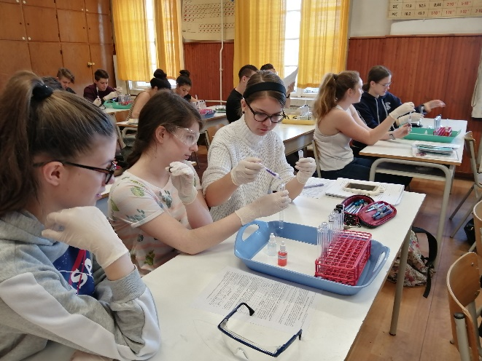
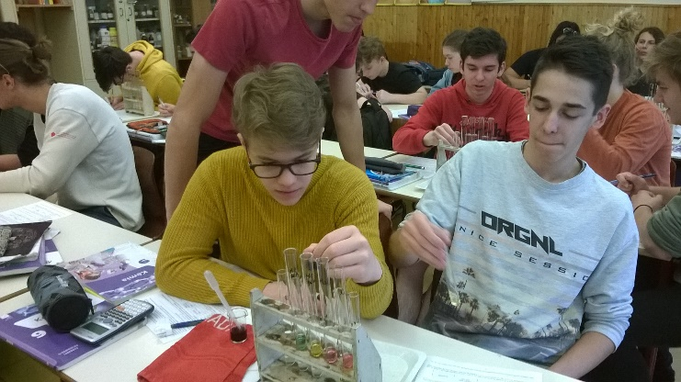
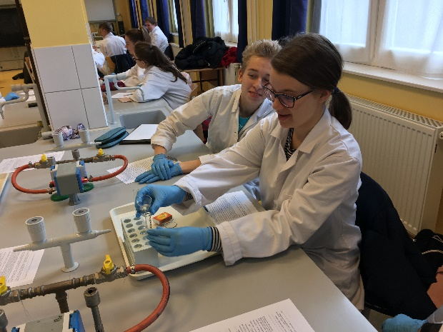
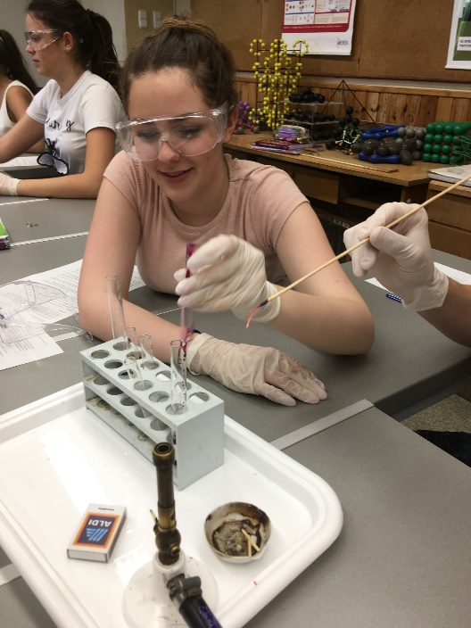
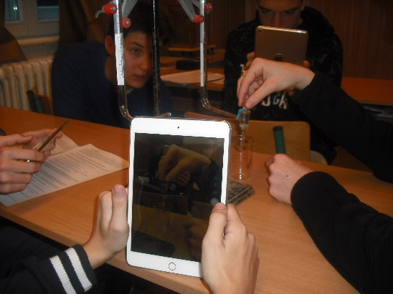
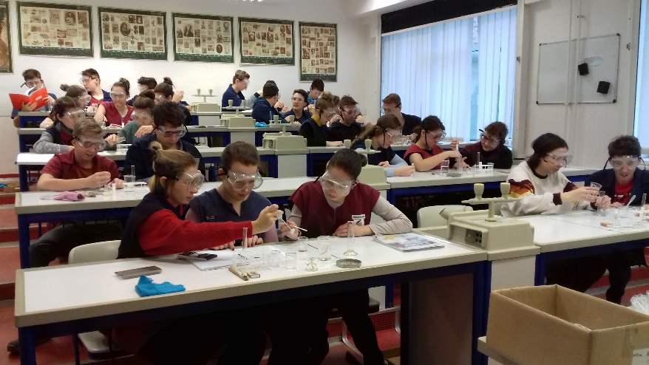
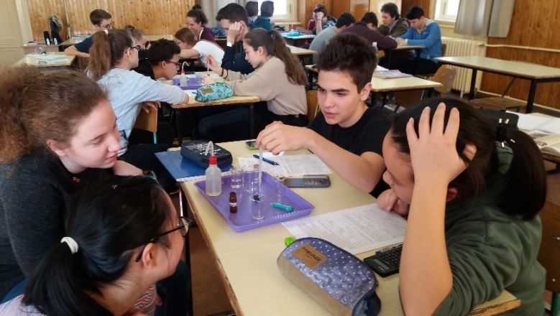
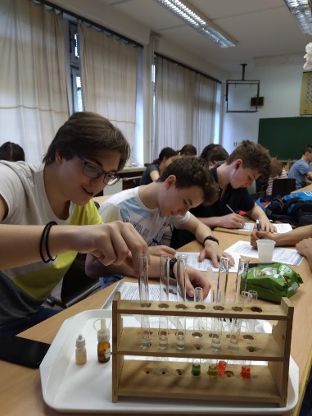
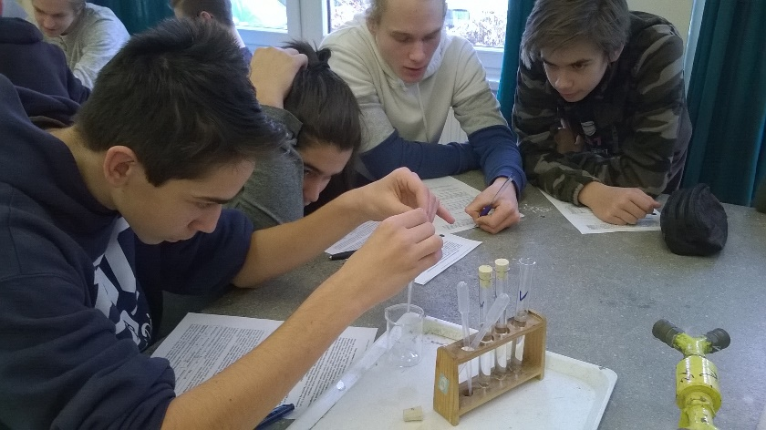
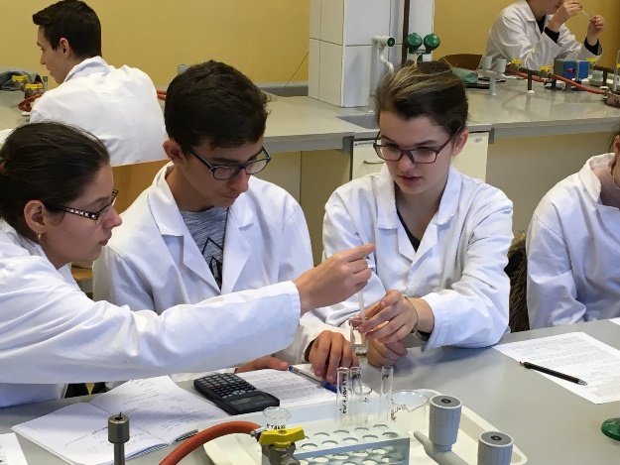
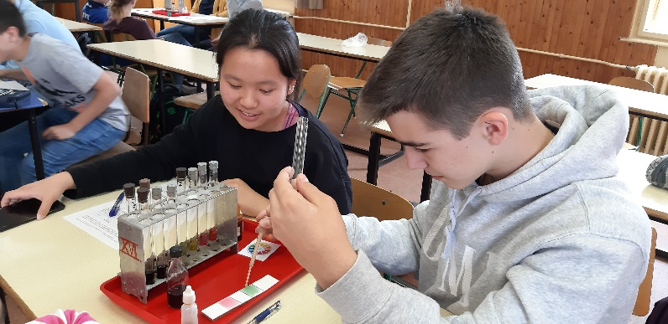
This study was funded by the Content Pedagogy Research Program of the Hungarian Academy of Sciences. Website: http://ttomc.elte.hu/ publications/90 E-mail: luca@caesar.elte.hu THANK YOU FOR YOUR ATTENTION!
Notes:
See you soon (even if only in Zoom) and thank you very much for your attention.

